Slide 1
Global Retail Performance & Revenue Assurance
-Sharoon Roja German. A

Slide 2

About Data
This project is based on a transactional dataset of a UK-based non-store online retailer. It captures every single interaction between the business and its global customers over a one-year period.

Slide 3
Nature of Data: It’s a B2C (Business to Consumer) dataset containing both successful sales and product returns.
Scale: The dataset is massive, consisting of over 5,31,180 data from 5,36,438 Raw Data which allows for high-level statistical significance.
Scope: It covers transactions across 38+ countries, making it a "Global Market Analysis" project.
Business Logic: The data isn't just numbers; it represents customer demand, inventory movement, and financial health (Revenue vs. Loss).

Slide 4
Data & column explanation

Slide 5
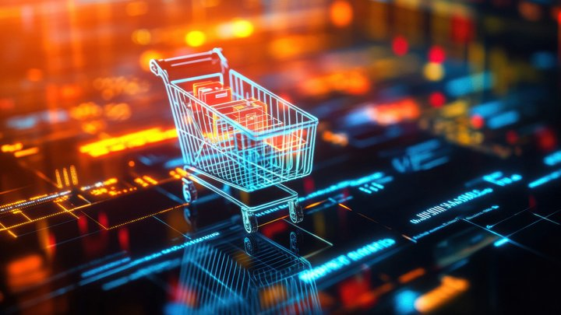
Invoice No - Used to count unique orders. It helps distinguish between a single large order and multiple small orders.
Stock Code - Essential for SKU-level (Stock Keeping Unit) tracking. It helps the warehouse team identify which specific product codes are moving fast or sitting idle.
Description - It allows the marketing team to know which specific items resonate with customers.
Quantity - Helps in understanding the volume of stock needed.
Invoice Date – It indicates date of billing the product. Invoice date also includes timing.
Unit Price - Used to analyze price sensitivity. It helps the business decide if they are a premium.
Customer ID - Crucial for identifying "Repeat Buyers" vs. "One-time Shoppers.
Country - Identifies high-performing geographic regions. This guides where the business should spend its advertising budget and where to expand logistics.

Slide 6
Column added
S.No (Serial No) - A unique incremental integer assigned to every row in the dataset.
Timing (Hour) - Extracted the 'Hour' component from the Invoice Date timestamp.
Weekday - Extracted the specific day of the week (Monday-Sunday) from Invoice Date.
Customer Type - Categorized customers into 'New' or 'Regular' based on their purchase frequency.
Status - A flag column identifying if a transaction was a 'Sold' or 'Returned' item.
Revenue - A calculated field (Quantity \UnitPrice) for each transaction.

Slide 7
Data cleaning
&
Pre-processing
Work flow

Slide 8

Handling Missing Values (Null Treatment)
Removed duplicates (5,258 Duplicates Found and removed).
Identified significant missing values in the Customer ID.
Action: Changed records with null Customer ID to “Guest Customers” ensure the accuracy of customer-centric metrics like Loyalty and Retention.
2. Outlier and Integrity Check
Found records with zero Unit Price.
Action: Excluded transactions with zero unit price as they do not contribute to commercial Revenue.
3. Data Unification (The "Append" Strategy)
Sales and Returns data were in separate structures, preventing a holistic view and synchronized filtering.
Action: Performed Data Appending to merge both datasets into a "Single Source of Truth.
4. Feature Engineering (Derived Dimensions)
Extracted temporal attributes from the Invoice Date timestamp to create new columns: Timing (Hour), Weekday, and Month.

Slide 9
Sales & revenue analysis

Slide 10
Monthly Trend
Monthly Performance: The business experienced a steady growth trajectory, with a massive breakout in November, reaching approximately ₹14 Lakhs. This indicates that the business is highly driven by year-end seasonal shopping.
Revenue Growth: The upward trend from August to November suggests successful inventory preparation for the peak season.

Slide 11
Peak Hour Analysis
Peak Traffic Intelligence: Order volume is most concentrated between 10:00 AM and 3:00 PM.
This "Golden Window" is when the highest number of transactions are processed.

Slide 12
Overall Strategic Insight
The business relies heavily on Q4 seasonality.
To maximize ROI .Return On Investment is a performance measure used to evaluate the efficiency or profitability of an investment. It calculates how much profit or value you gain relative to the cost of that investment.
Marketing spend and inventory stocking should be prioritized for the August-November window, with daily flash sales or email blasts timed for 10:00 AM to capture peak active users.

Slide 13
Customer behavior & Loyalty

Slide 14
Peak Hour Analysis
The New vs. Regular Customer donut chart shows a healthy mix, but "Regular" customers provide the stable "floor" for monthly revenue.

Slide 15
Peak Hour Analysis
The Customer Loyalty line chart indicates that while new customers are being acquired, the core revenue is driven by a repeat-purchase cycle.

Slide 16
Overall strategic insights
The brand has high trust and retention.
However, since the AOV is relatively low (£518), the next phase of growth should focus on "Average Basket Size" optimization.
Implementing "Frequently Bought Together" bundles or a "Free Shipping over £1,000" threshold could significantly boost the Net Revenue without needing new customers.

Slide 17
Return
&
Risk Analysis

Slide 18
Product analysis
Revenue Leakage: The dashboard identifies a 4.6% Return Rate, which translates to a ₹4.75 Lakh loss from the Gross Sales.
High-Risk Products: Specific items like the “Regency Cakestand” and “Jam Making Set” appear in the high-return category.

Slide 19
loss analysis
Financial Impact: The Revenue Loss Analysis (Waterfall chart) shows that while Gross Sales are over ₹1 Crore, returns are the primary "leak" preventing the business from reaching higher net profitability.

Slide 20
Overall Strategic Insight
A 4.6% return rate is manageable but can be improved.
By performing a targeted Quality Audit on the top 5 most-returned products, the business can reduce logistics and refund costs, potentially saving ₹1 Lakh annually in operational "waste."

Slide 21
Geographical insights

Slide 22
Emerging markets
UNITED KINGDOM
Dominant Market: The United Kingdom is the powerhouse, contributing the vast majority of sales and unique invoice counts

Slide 23
Emerging markets
GERMANY FRANCE NETHERLAND
Emerging Markets: Countries like Germany, France, and the Netherlands are showing consistent growth and higher AOV compared to some smaller regions.

Slide 24
OVERALL STRATEGIC INSIGHTS
Market Diversification: The "Country" analysis shows that while the business is global, there is a heavy reliance on the UK market, which poses a risk if local economic conditions change.
The business has a strong international footprint but is UK-centric. The strategic goal should be to "copy-paste" the UK success into Germany and France by localizing marketing and potentially setting up regional distribution hubs to reduce the shipping times that might be contributing to international returns.

Slide 25
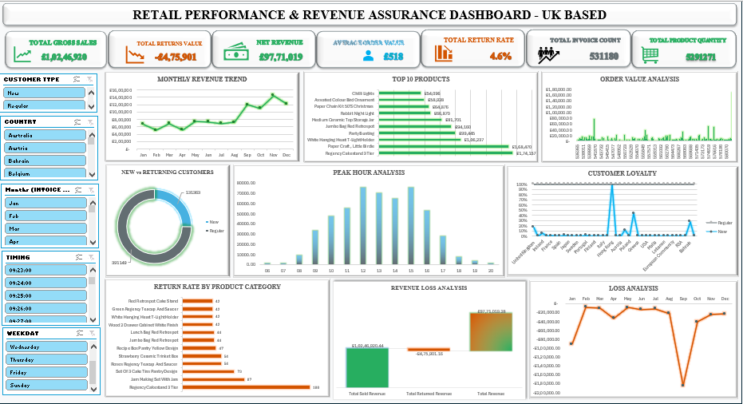

Slide 26
Conclusion
Financial Health: Net Revenue of ₹97.71 Lakhs with a solid ₹518 AOV.
Core Strength: Exceptional performance during the Holiday Season and high Customer Loyalty.
Action Plan: "Plug" the 4.6% revenue leakage by fixing high-return products and increase the AOV through strategic product bundling during peak hours.

